Slide 1

COVID-19
Jiaqing(Jessica) Wang
Canny
Yanxin (Yancy) Pang
Ruiyang (Ray) He

Slide 2
Introduction of Dataset
Explore the global data on confirmed COVID-19 cases FROM 2020 TO 2022
Count the daily number of confirmed cases to find out the impact on the country and people's lives
Global comparison: where are confirmed cases increasing most rapidly

Slide 3
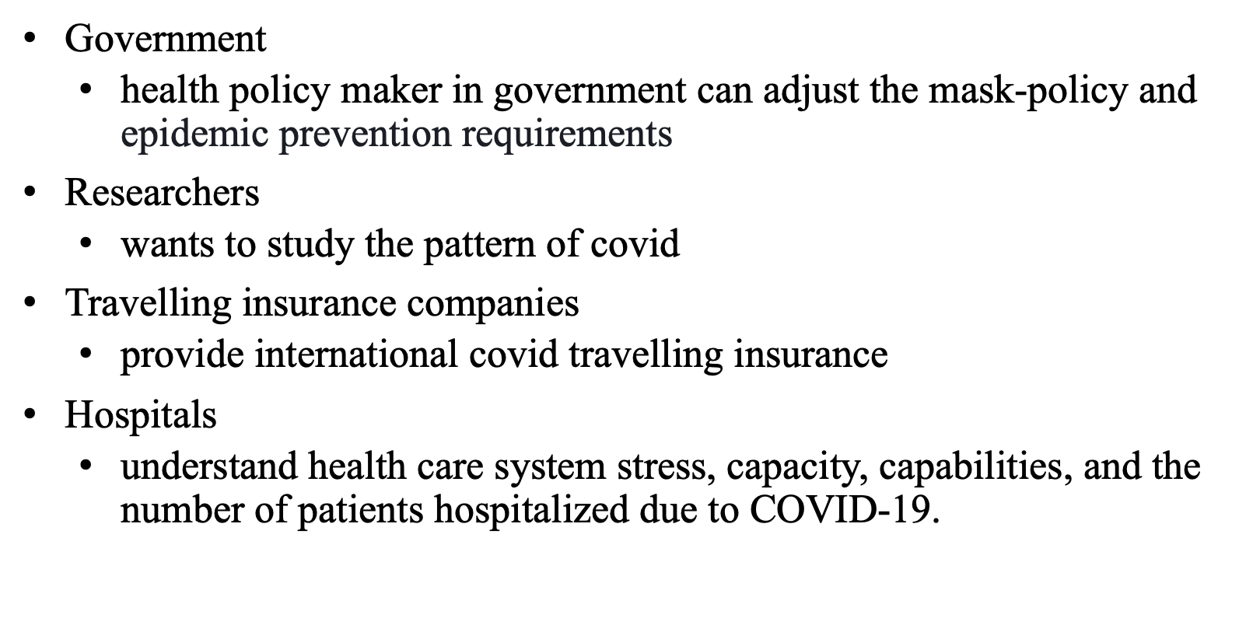
Purpose

Slide 4
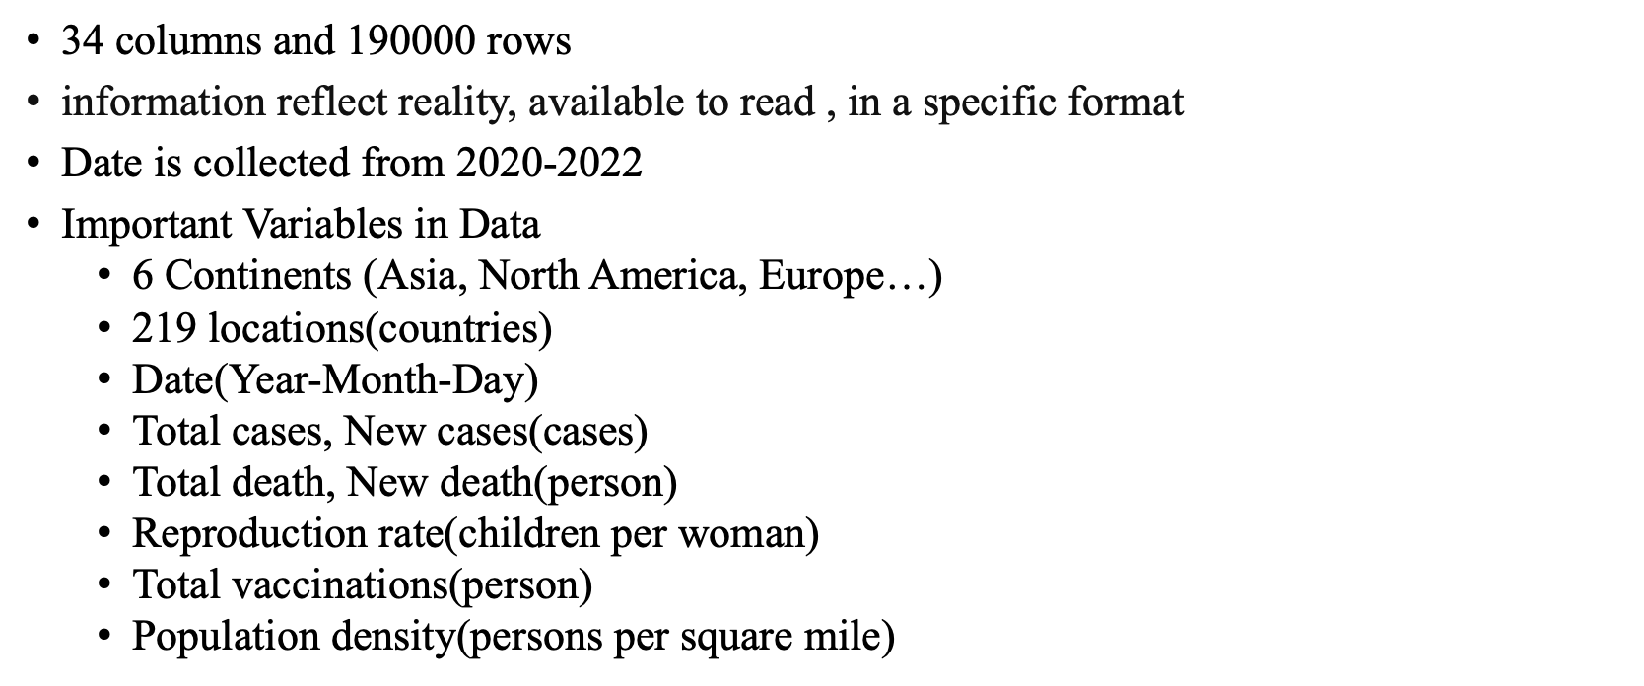
DATA OVERVIEW

Slide 5
Source of the data
Area of Data | Source
Cases & Deaths | JHU CSSE COVID-19 Data
Hospital & ICU; Test & Positivity; Vaccination | Official data pass to OWID team
Country Information | International Organizations (UN, World Bank…)
Excess Mortality | Human Mortality Database & World Mortality Dataset
Notes:
Source: https://ourworldindata.org

Slide 6

Source of the data
Our World In Data
Access the data
Notes:
Source: https://ourworldindata.org

Slide 7
Data Preparation
Data cleaning:
NA value (Drop some empty and outlier)
Date interval (Feb-22-2020 to 8-Oct-2022), Unit(Month or Day)
Arrange (By time)
Cross-sectional and Time series Data
Distinguish between continents
Countries with missing records were omitted

Slide 8
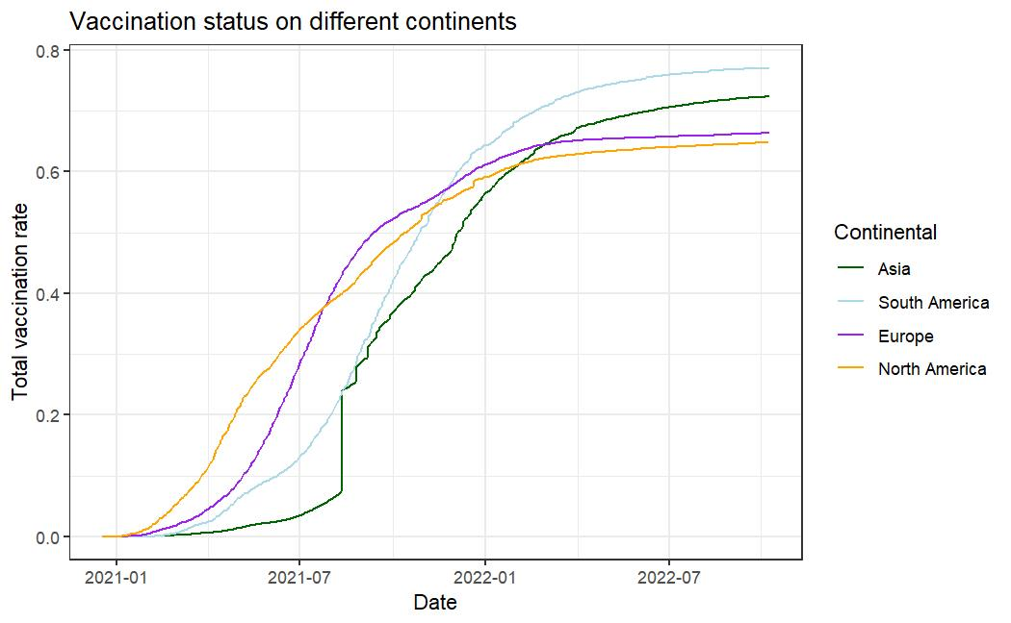
Vaccination Status
Progress of full vaccination in different continents
Europe and North America were faster at first six month.
Total vaccinated Rate = Number of fully vaccination divide by Population

Slide 9
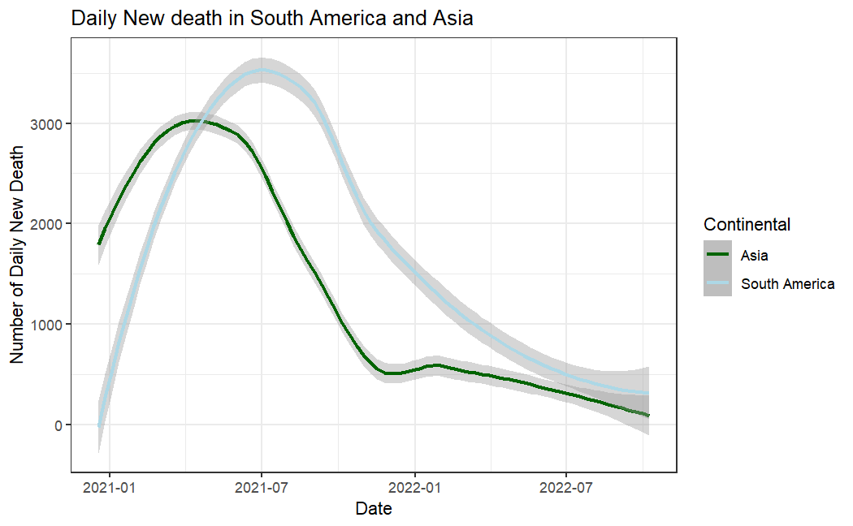
..
.

Slide 10
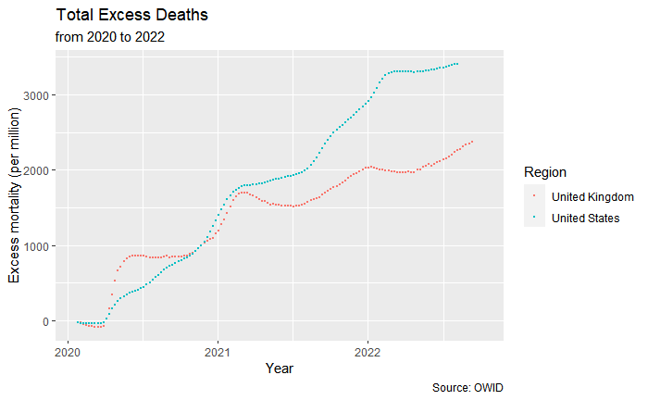
Excess Mortality:
Project the death using
Last Year
History
Compare to the total death reported

Slide 11
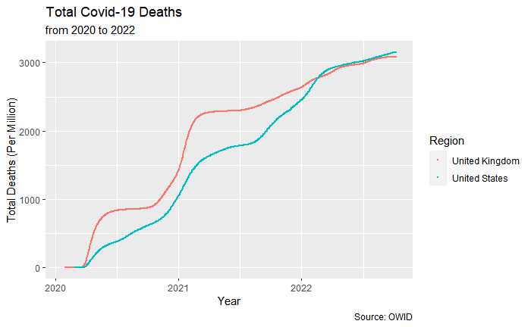
Different from the excess death chart

Slide 12
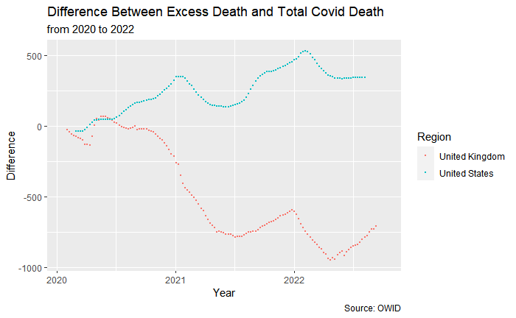
Notes:
UK Treasury pushes to end most free Covid testing despite experts’ warnings | Coronavirus | The Guardian

Slide 13
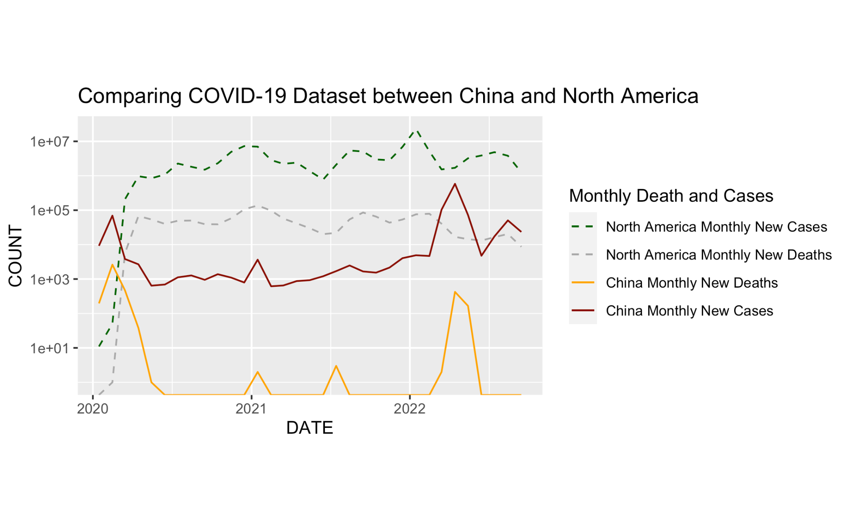
China first start the COVID pandemic in 2020, but controls very well in late 2020 and 2021. The Y-axis is in proportionally increase.
North America have a much higher trend than China in COVID-19 cases and deaths( 1e+01=10)
Both has rebounded in new cases death cases in 2022

Slide 14
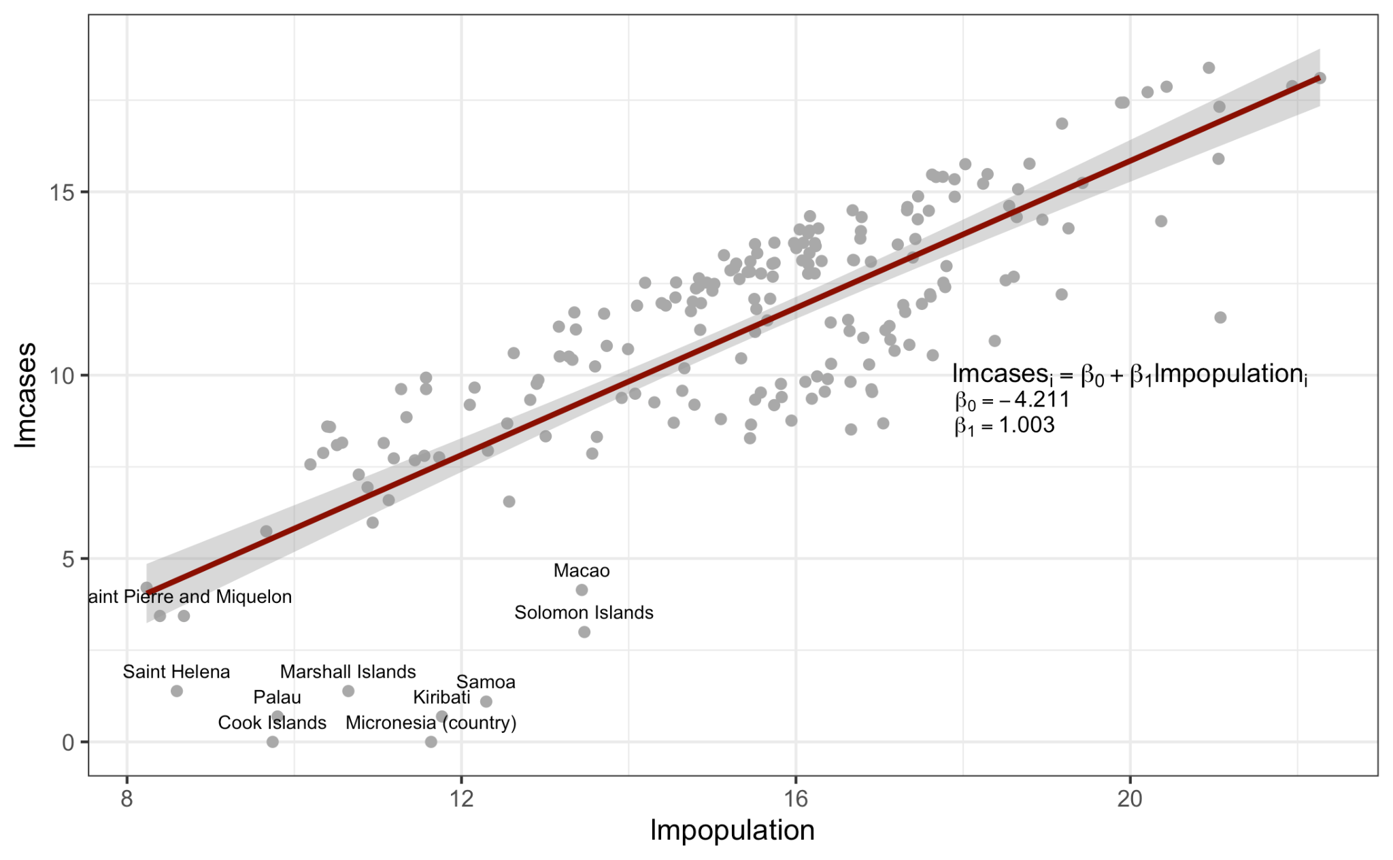
Logarithm Linear regression between population and cases

Slide 15
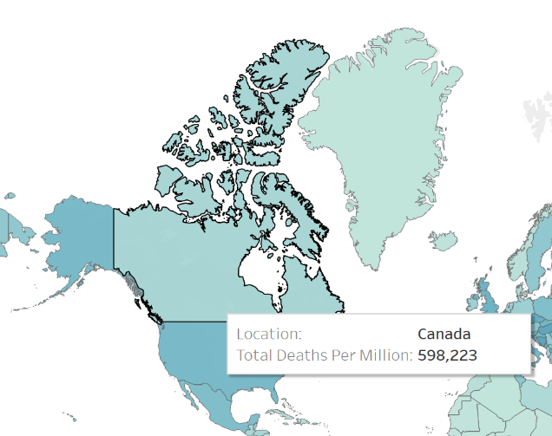
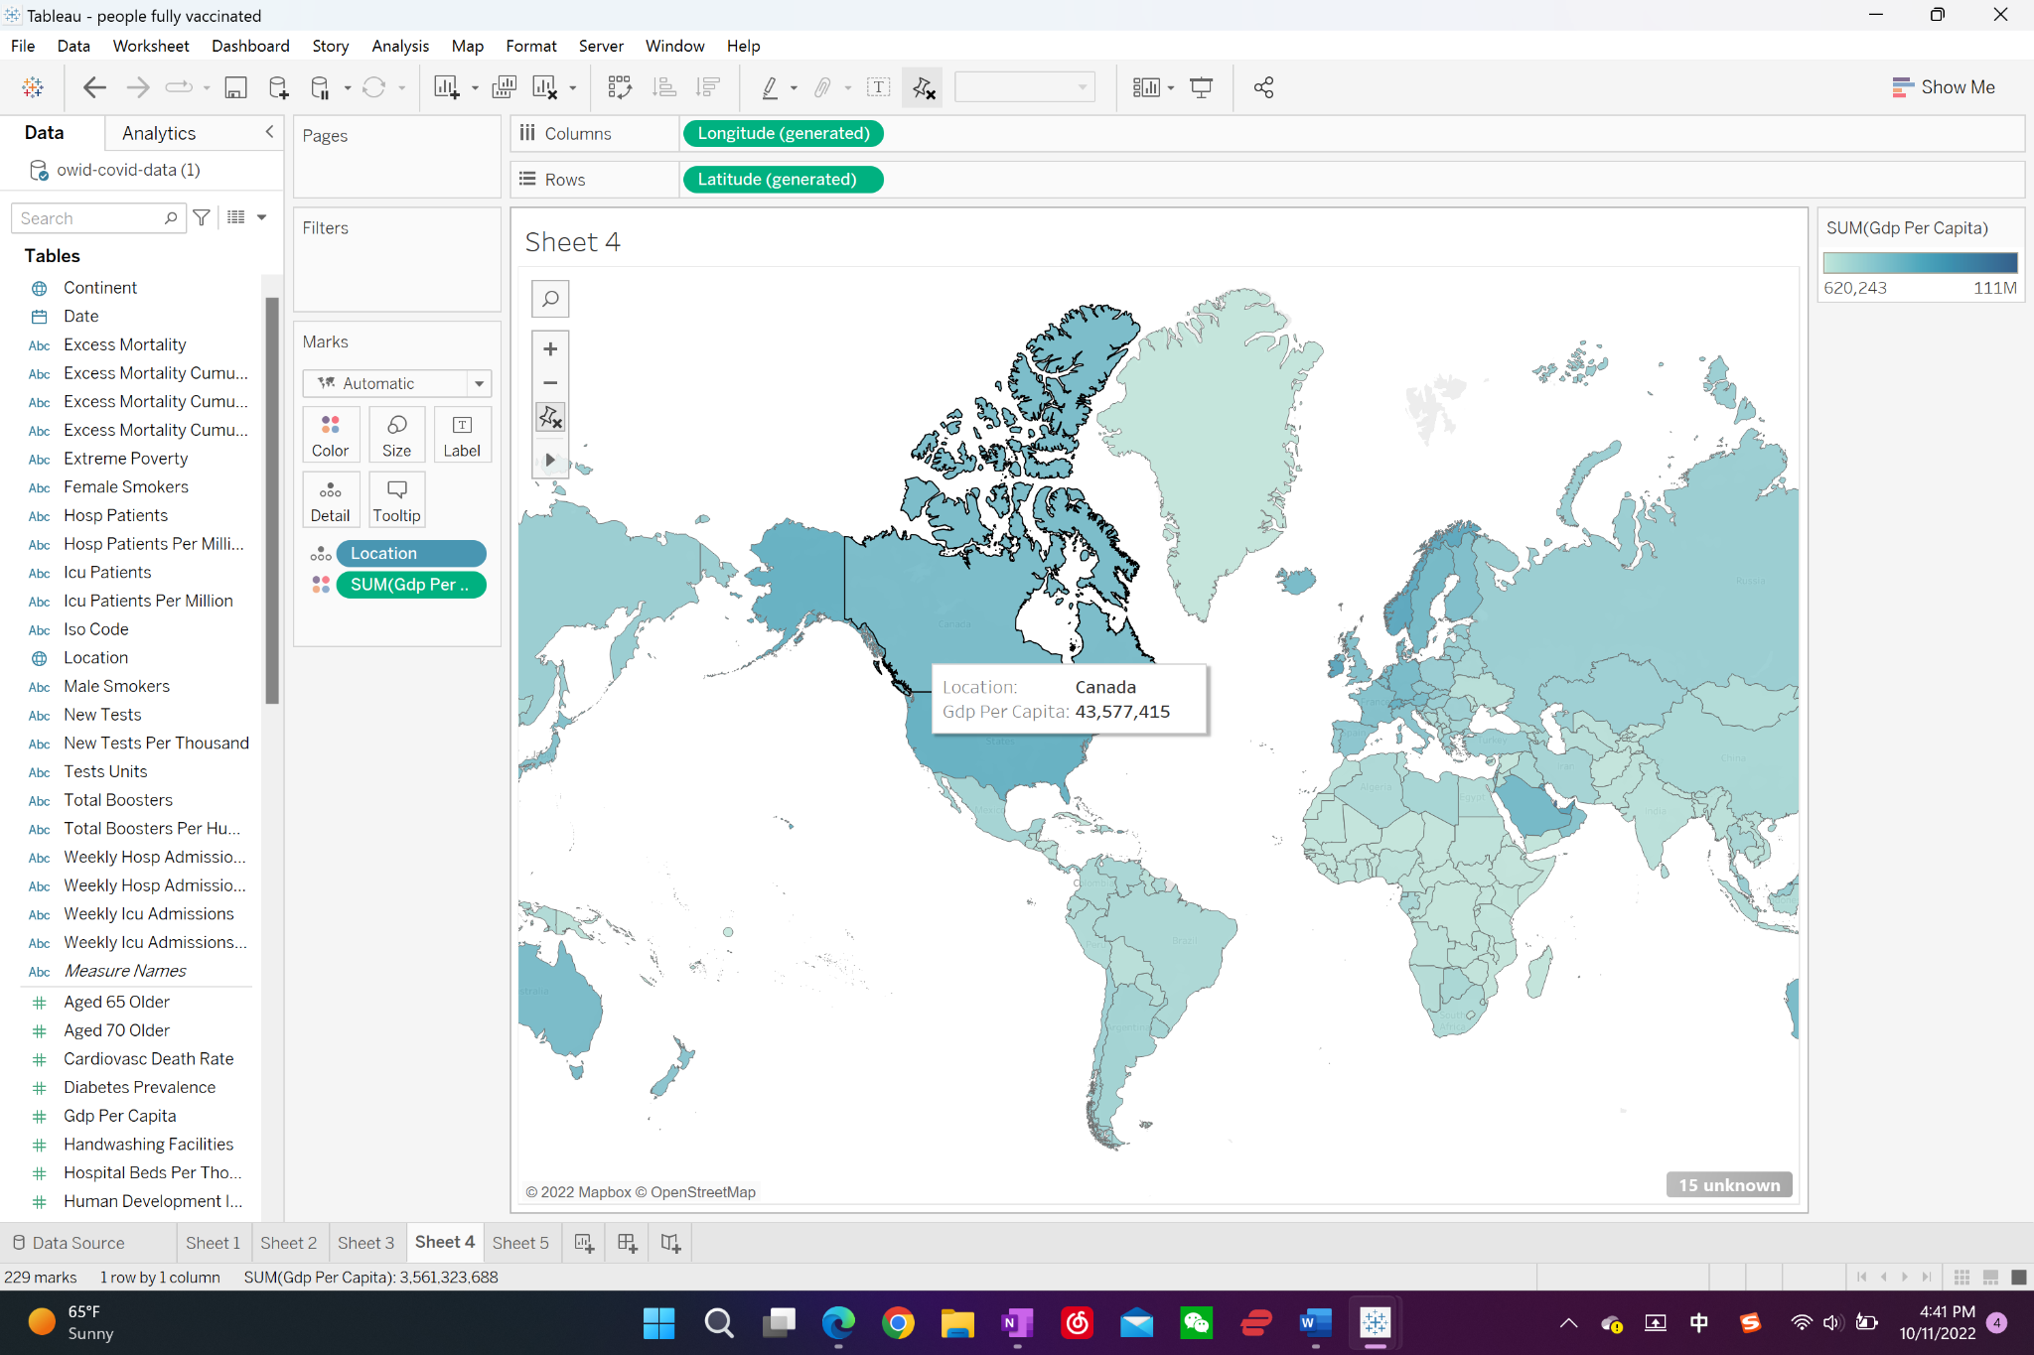
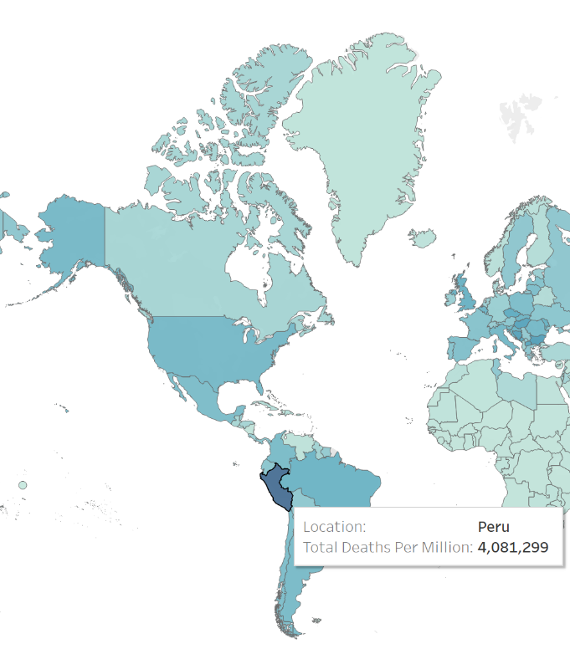
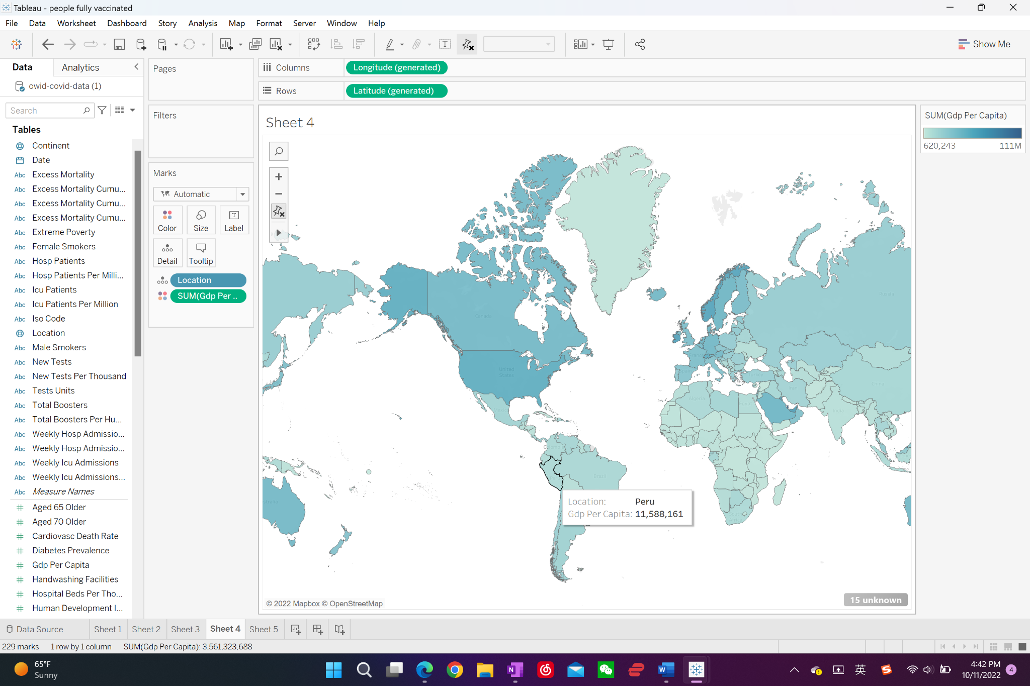
Total Death vs. GDP in North & South America

Slide 16
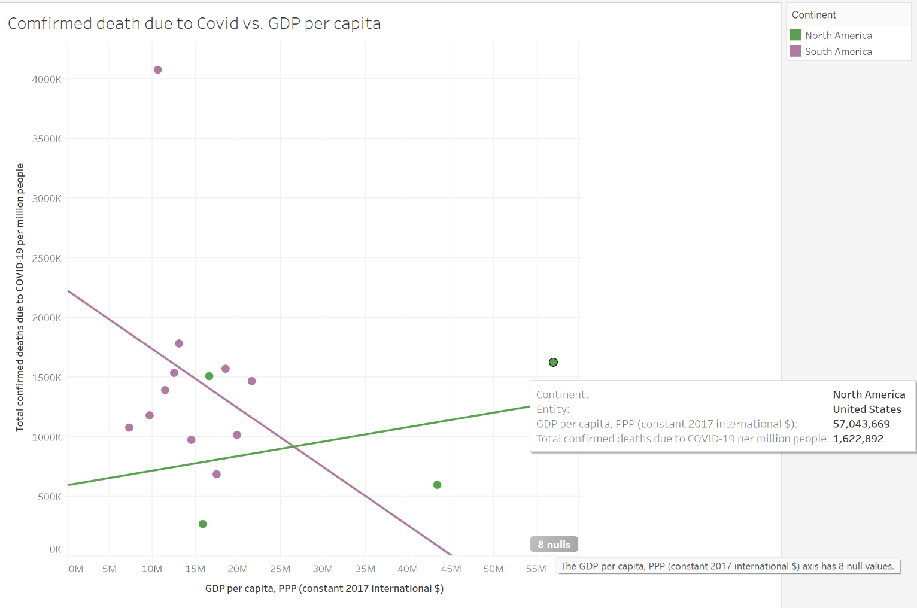
Total Death vs. GDP in North & South America
A potential trend: as GDP↑, Death by Covid↓
Countries not following this pattern could be:
Religious reason
Not willing to wear mask/take vaccine
Distrust their government
Notes:
.

Slide 17
Conclusion:
Pros:
Covered lots of topics, discovered various relationships between different variables. Provided abundant introductory material for students who are interested in with worldwide Covid situation
Cons
Had to drop out lots of missing values, limited the information reflected on graph
Could only reflect the Covid situation on a country level. Cannot present detailed information regarding cities
Future goals:
Build graphs with more complexity to reflect further influence brought by Covid

Slide 18
Q&A

